Slide 1


Computer Organization and Architecture
Div C SY COMP
Sem III
Snehal
AY 2024-25

Slide 2


Computer Organization and Architecture
Course Outcomes
At the end of successful completion of the course the student will be able to
CO 1. Describe and define the structure of a computer with buses structure and detail working of the arithmetic logic unit and its sub modules
CO 2. Understand the Central processing unit with addressing modes and
working of control unit in depth
CO 3. Learn and evaluate memory organization and cache structure
CO 4. Summarize Input output techniques and multiprocessor configurations

Slide 3
Module 1
Structure of a Computer System
1.1
Introduction of computer system and its sub modules, Basic organization of computer and block level description of the functional units. Von Neumann model
1.2
Introduction to buses, bus types, and connection I/O devices to CPU and memory, PCI and SCSI

Slide 4
Architecture & Organization
Architecture :Attributes visible to the programmer – Instruction set, number of bits used for data
representation, I/O mechanisms, addressing techniques.
Organization : How features are implemented
Control signals, interfaces, memory technology.
e.g. Is there a hardware multiply unit or is it done by repeated addition?

Slide 5
Architecture & Organization
Architecture involves Logic
(Instruction sets, Addressing modes, Data types, Cache optimization)
Organization involves Physical Components (Circuit design, Adders, Signals, Peripherals)

Slide 6
Architecture & Organization
All Intel x86 family share the same basic architecture
The IBM System/370 family share the same basic architecture
This gives code compatibility – At least backwards
Organization differs between different versions

Slide 7
Performance of Computer
Parameters
Clock Speed
Bus Width
MIPS
Power consumption
Price

Slide 8
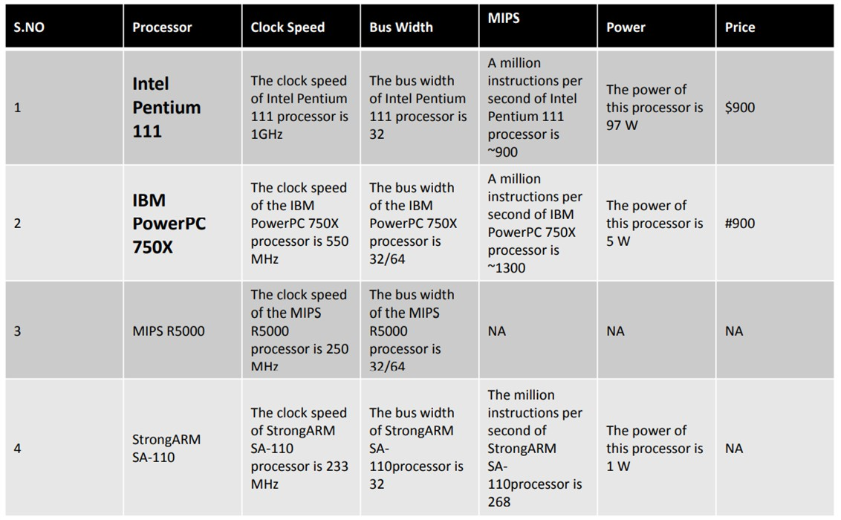
Performance of Processor

Slide 9
Structure and Function
Structure is the way in which components relate to each other
Function is the operation of individual components as part of the structure
Computer Functions:
Data processing
Data storage
Data movement
Control

Slide 10
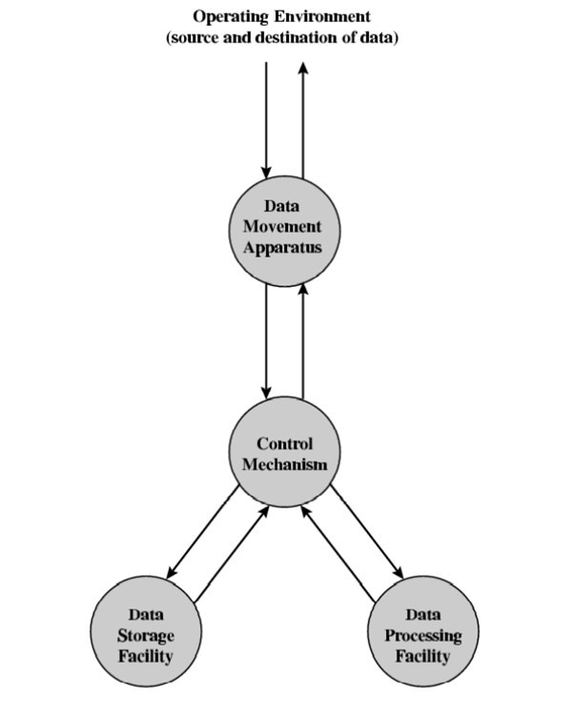
Functional View

Slide 11
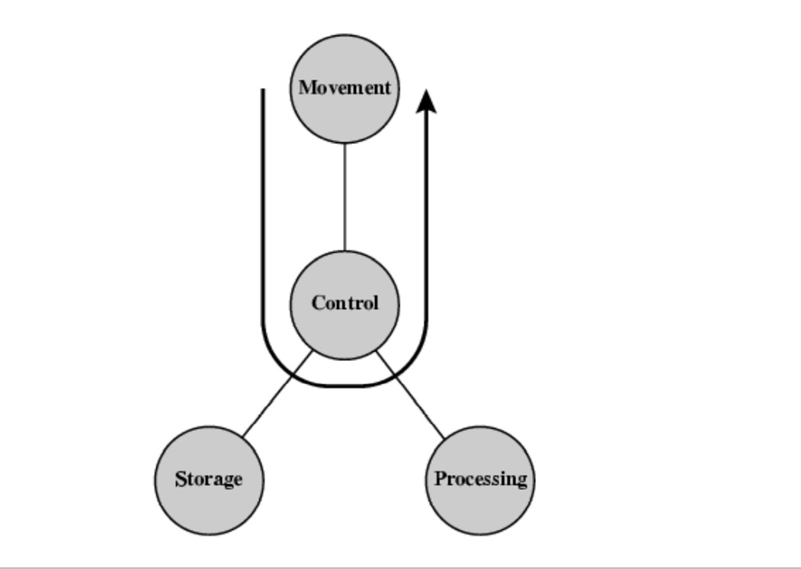
Data Movement

Slide 12
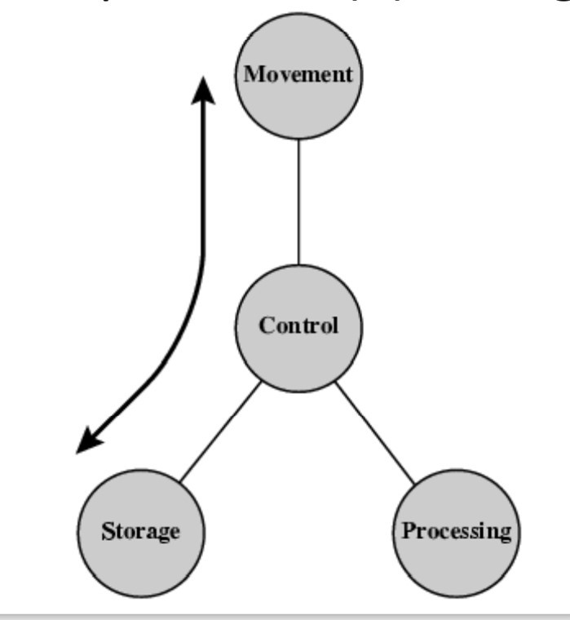
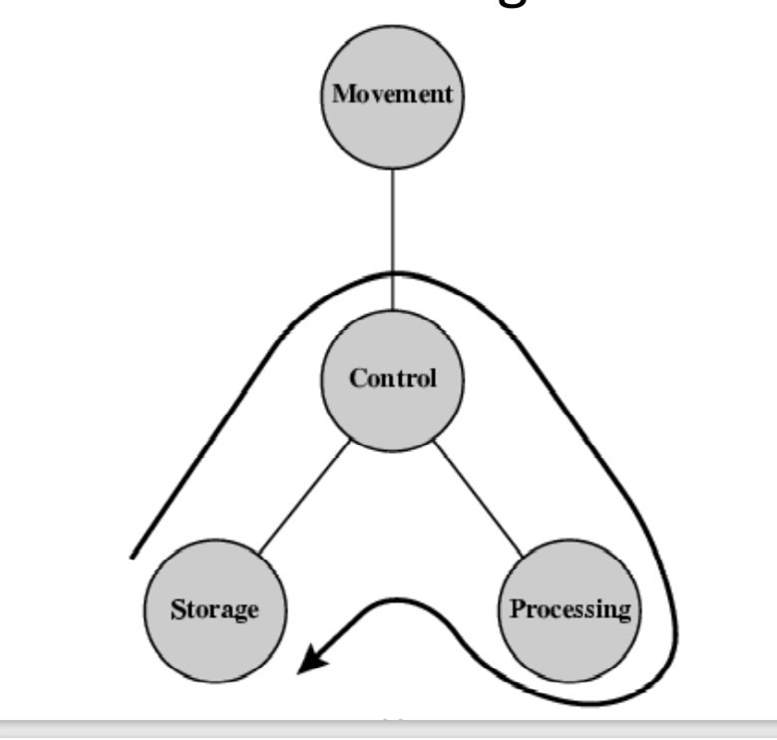
Storage and Processing

Slide 13
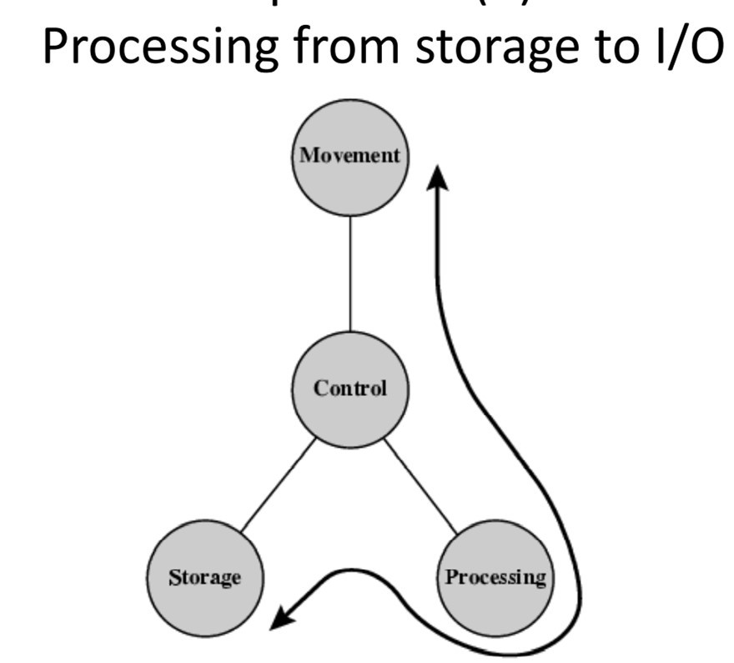

Slide 14
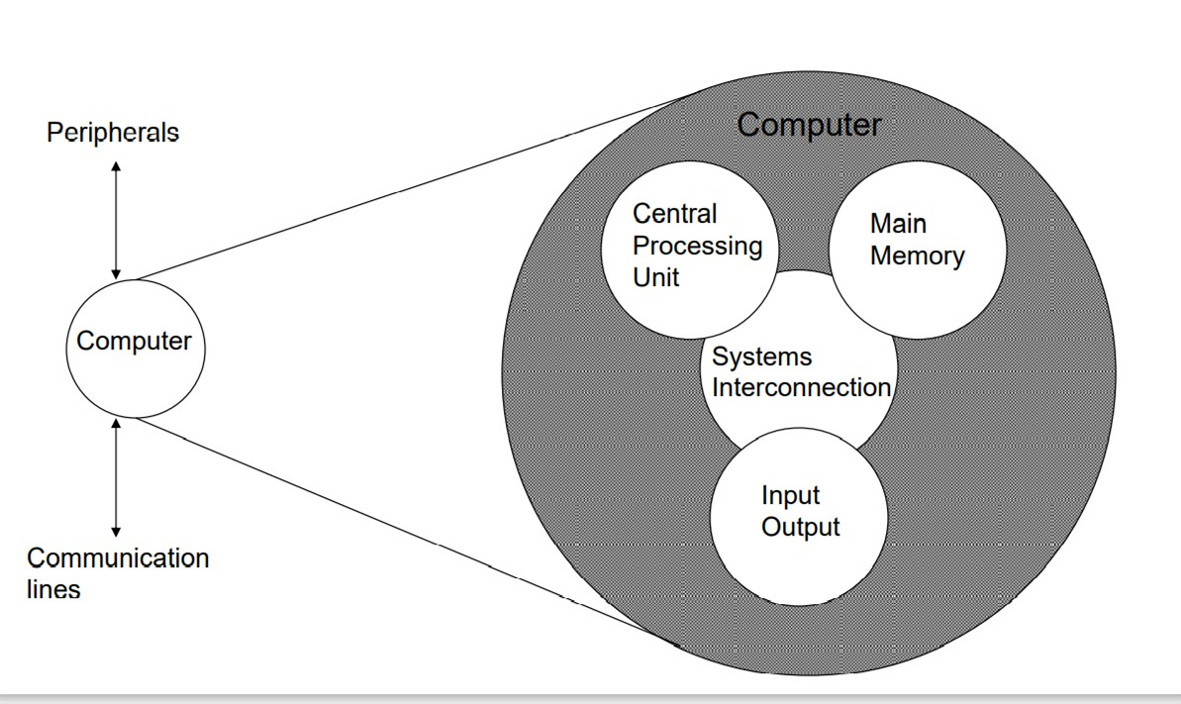
Structure : Top Level

Slide 15
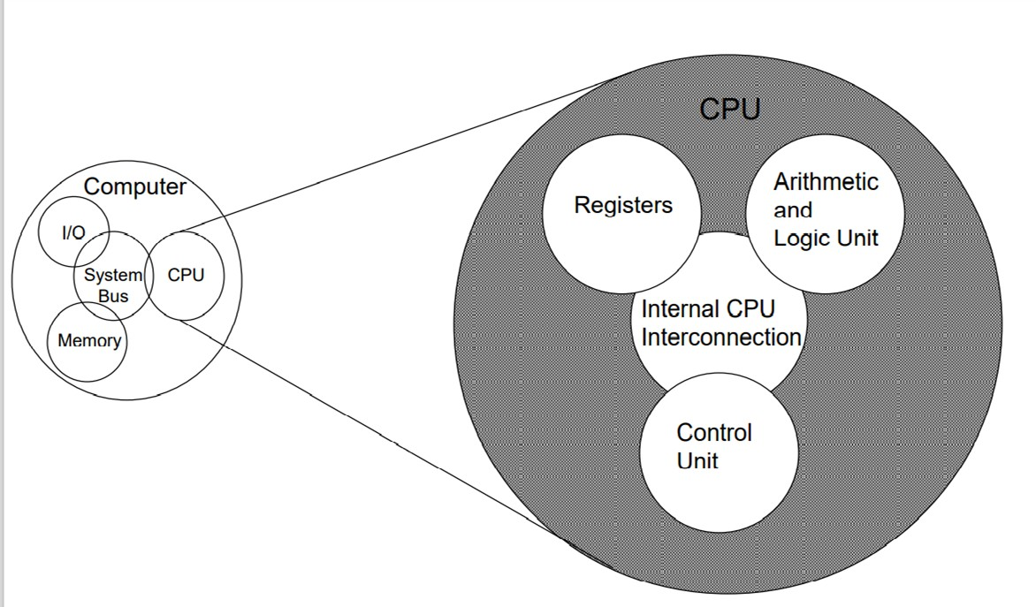
Structure : Central Processing Unit

Slide 16
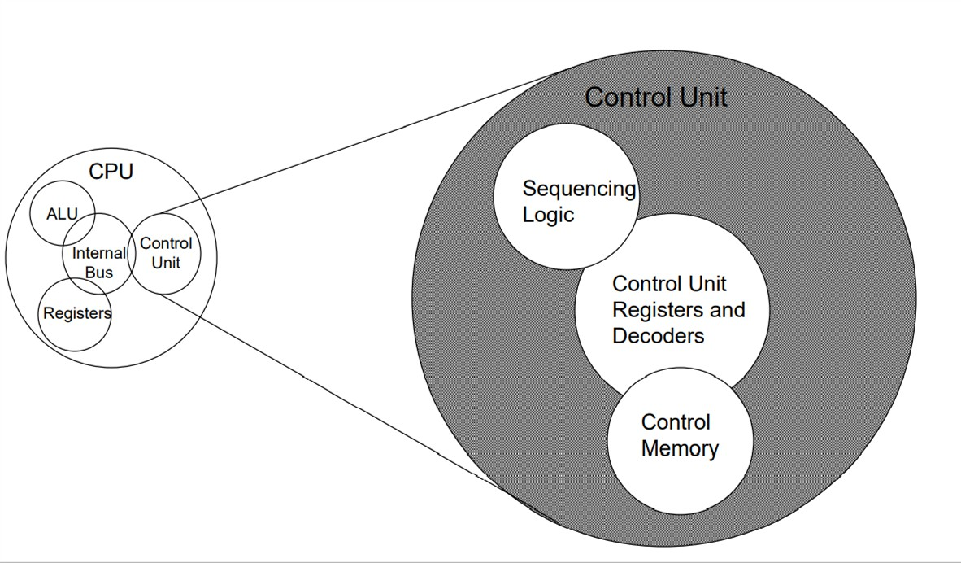
Structure : Control Unit

Slide 17
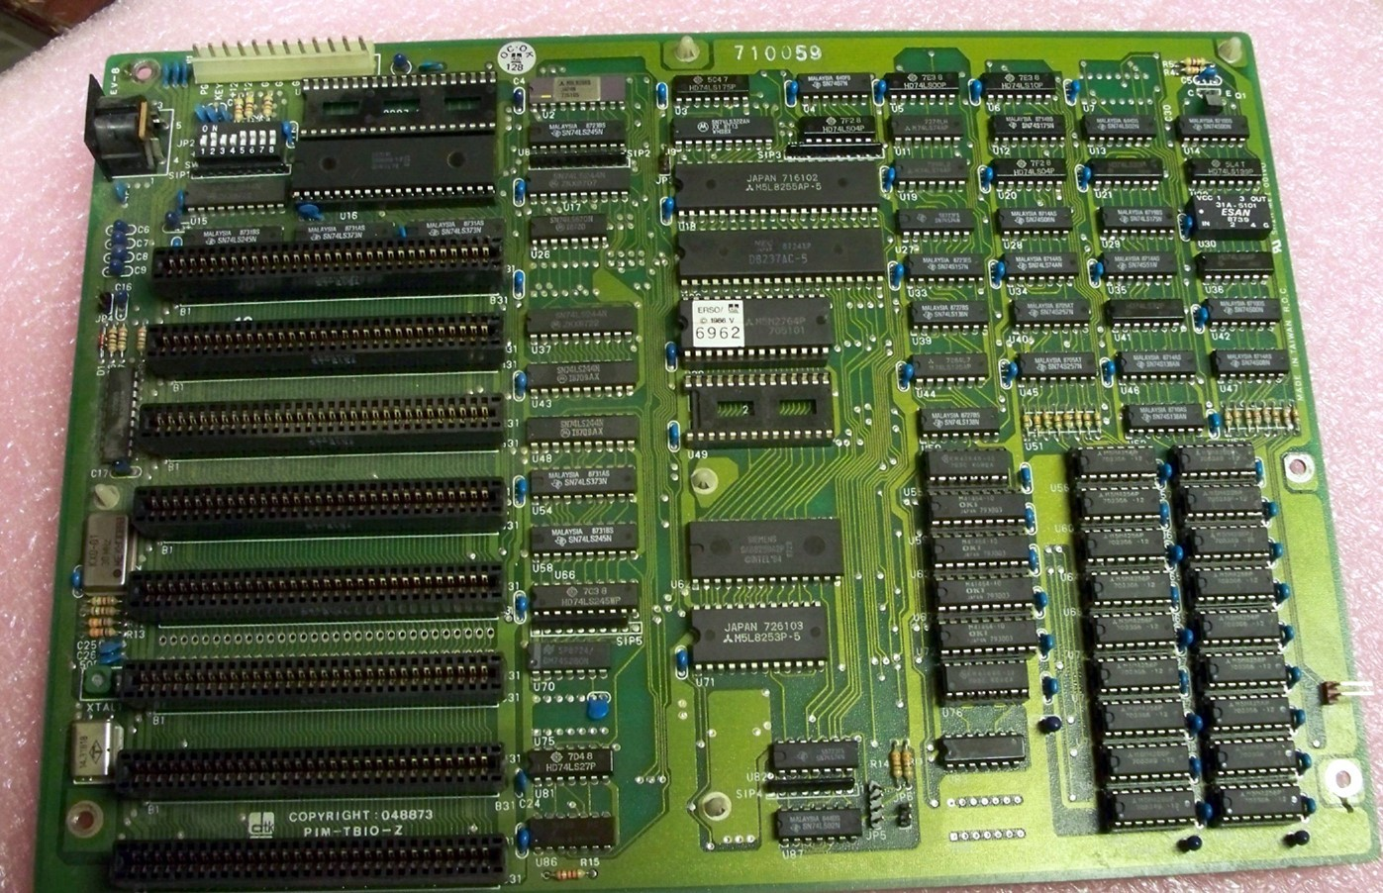
Recap

Slide 18
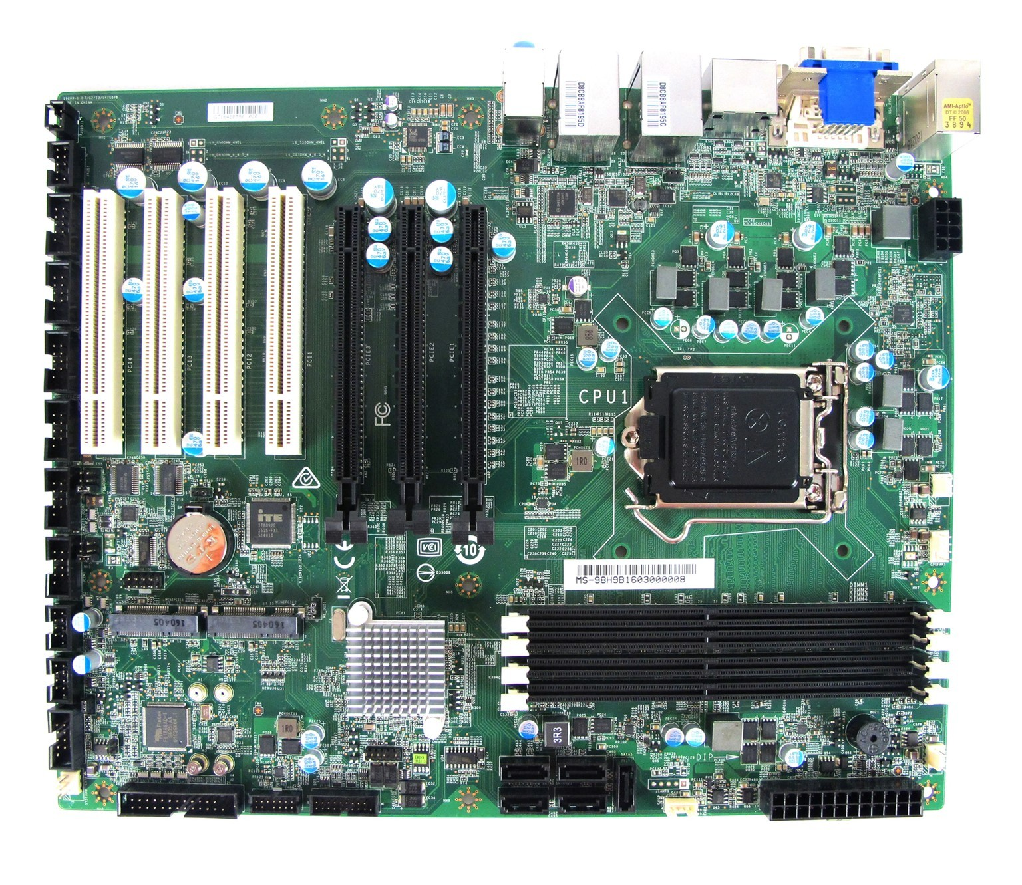
Recap

Slide 19
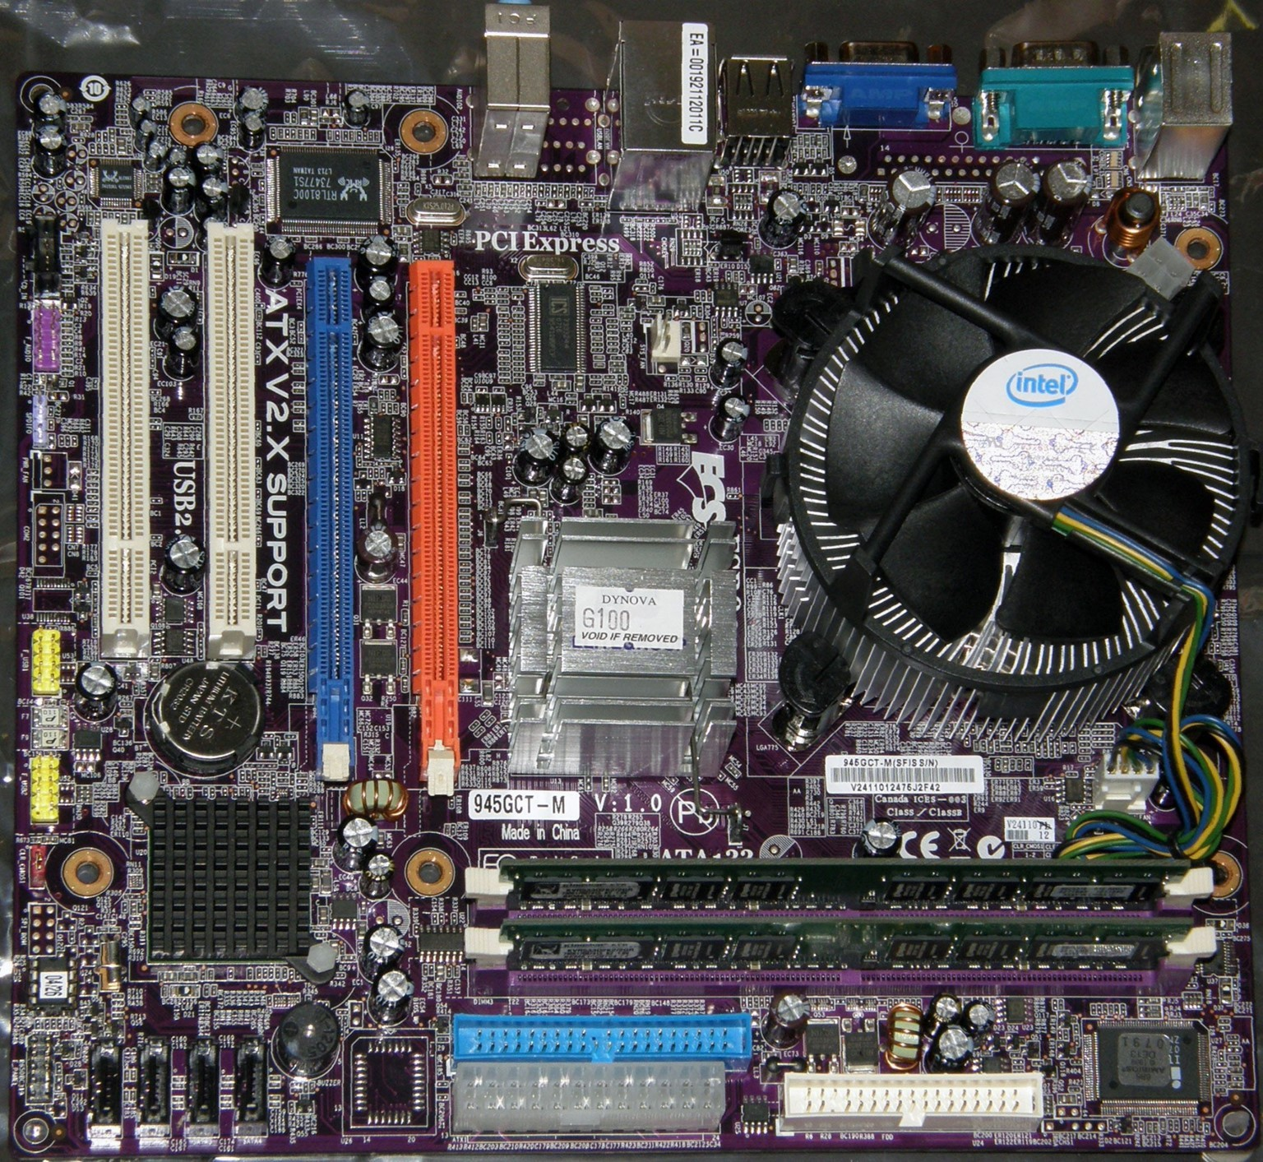
Recap

